Slide 1


Data-Intensive Distributed Computing
CS 451/651 (Fall 2018)
Part 8: Analyzing Graphs, Redux (1/2)
November 15, 2018
Jimmy Lin
David R. Cheriton School of Computer Science
University of Waterloo
These slides are available at http://lintool.github.io/bigdata-2018f/
This work is licensed under a Creative Commons Attribution-Noncommercial-Share Alike 3.0 United States See http://creativecommons.org/licenses/by-nc-sa/3.0/us/ for details

Slide 2
Graph Algorithms, again?
(srsly?)

Slide 3
✗
What makes graphs hard?
Fun!
Irregular structure
Fun with data structures!
Irregular data access patterns
Fun with architectures!
Iterations
Fun with optimizations!

Slide 4
Characteristics of Graph Algorithms
Parallel graph traversals
Local computations
Message passing along graph edges
Iterations

Slide 5
Visualizing Parallel BFS
n₇
n₀
n₁
n₃
n₂
n₆
n₅
n₄
n₈
n₉

Slide 6
PageRank: Defined
Given page x with inlinks t₁…t_{n}, where
C(t) is the out-degree of t
α is probability of random jump
N is the total number of nodes in the graph
t₁
X
t₂
…
t_{n}

Slide 7
PageRank in MapReduce
n₁ [n₂, n₄]
n₂ [n₃, n₅]
n₃ [n₄]
n₄ [n₅]
n₅ [n₁, n₂, n₃]
Map
n₂
n₄
n₃
n₅
n₄
n₅
n₁
n₂
n₃
n₁
n₂
n₂
n₃
n₃
n₄
n₄
n₅
n₅
Reduce
n₁ [n₂, n₄]
n₂ [n₃, n₅]
n₃ [n₄]
n₄ [n₅]
n₅ [n₁, n₂, n₃]

Slide 8
PageRank vs. BFS
PageRank
BFS
Map
PR/N
d+1
Reduce
sum
min

Slide 9
Characteristics of Graph Algorithms
Parallel graph traversals
Local computations
Message passing along graph edges
Iterations

Slide 10
BFS
HDFS
map
reduce
Convergence?
HDFS

Slide 11
PageRank
HDFS
map
map
Convergence?
reduce
HDFS
HDFS

Slide 12
MapReduce Sucks
Hadoop task startup time
Stragglers
Needless graph shuffling
Checkpointing at each iteration

Slide 13
Let’s Spark!
HDFS
map
reduce
HDFS
map
reduce
HDFS
map
reduce
HDFS
…

Slide 14
HDFS
map
reduce
map
reduce
map
reduce
…

Slide 15
HDFS
map
Adjacency Lists
PageRank Mass
reduce
map
Adjacency Lists
PageRank Mass
reduce
map
Adjacency Lists
PageRank Mass
reduce
…

Slide 16
HDFS
map
Adjacency Lists
PageRank Mass
join
map
Adjacency Lists
PageRank Mass
join
map
Adjacency Lists
PageRank Mass
join
…

Slide 17
HDFS
HDFS
Adjacency Lists
PageRank vector
join
flatMap
reduceByKey
PageRank vector
join
flatMap
reduceByKey
PageRank vector
join
…

Slide 18
HDFS
HDFS
Adjacency Lists
PageRank vector
Cache!
join
flatMap
reduceByKey
PageRank vector
join
flatMap
reduceByKey
PageRank vector
join
…

Slide 19
MapReduce vs. Spark
Source: http://ampcamp.berkeley.edu/wp-content/uploads/2012/06/matei-zaharia-part-2-amp-camp-2012-standalone-programs.pdf

Slide 20
Characteristics of Graph Algorithms
Parallel graph traversals
Local computations
Message passing along graph edges
Iterations
Even faster?

Slide 21
Big Data Processing in a Nutshell
Let’s be smarter about this!
Partition
Replicate
Reduce cross-partition communication

Slide 22
Simple Partitioning Techniques
Hash partitioning
Range partitioning on some underlying linearization
Web pages: lexicographic sort of domain-reversed URLs

Slide 23
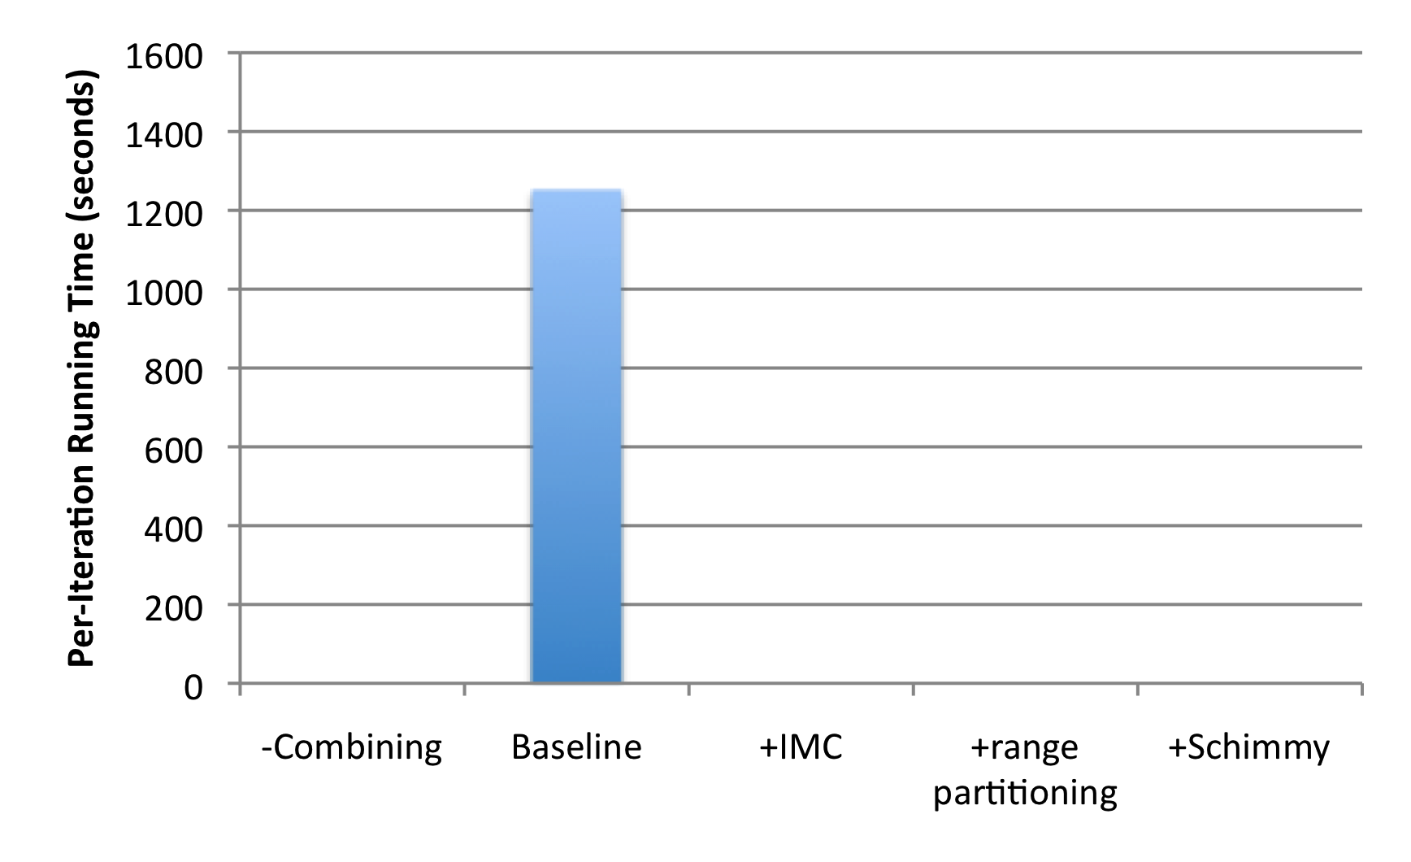
How much difference does it make?
“Best Practices”
PageRank over webgraph (40m vertices, 1.4b edges)
Lin and Schatz. (2010) Design Patterns for Efﬁcient Graph Algorithms in MapReduce.

Slide 24
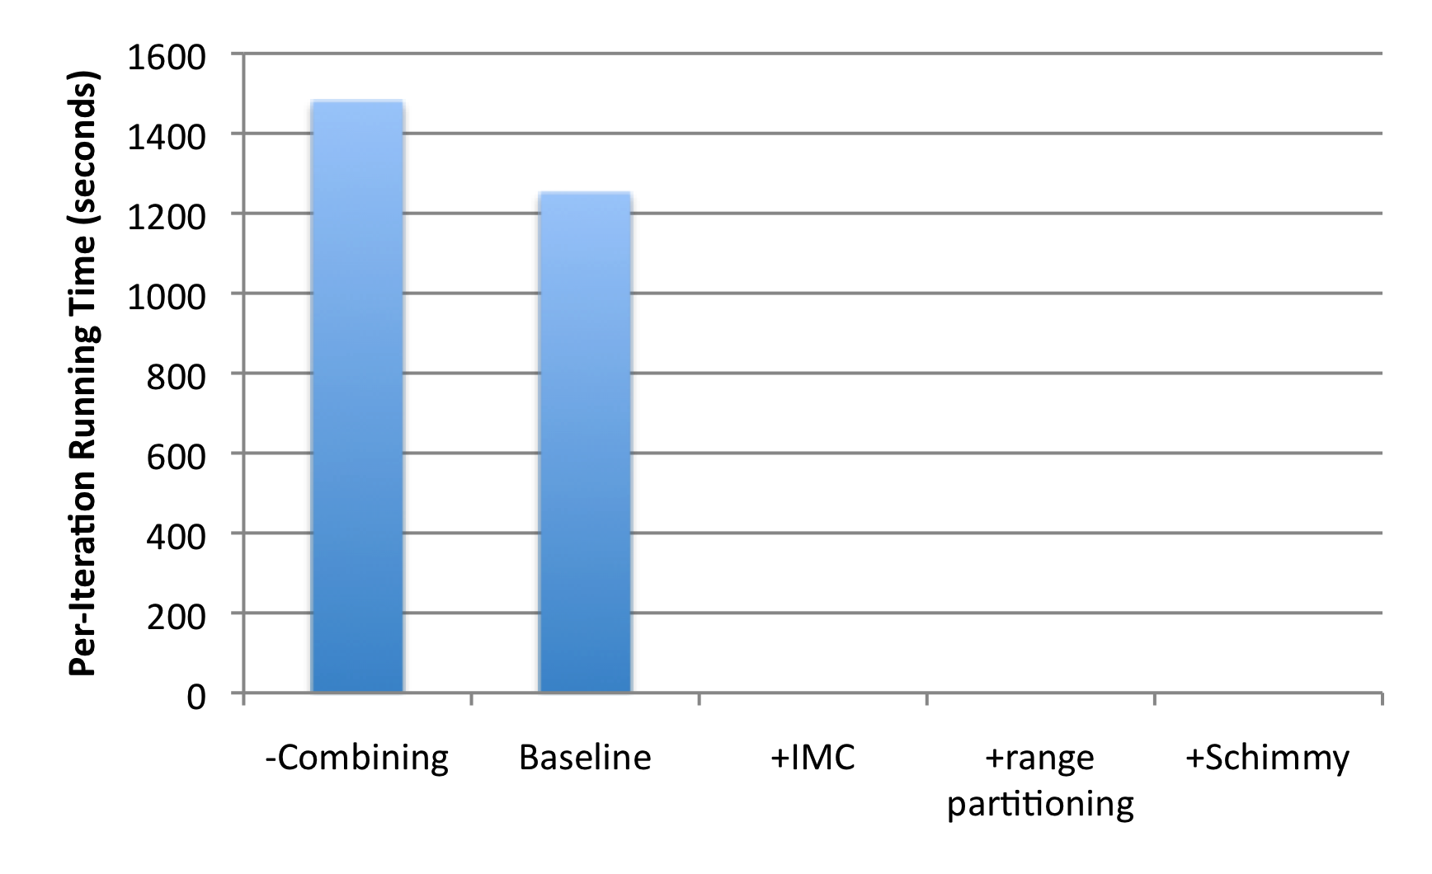
How much difference does it make?
+18%
1.4b
674m
PageRank over webgraph (40m vertices, 1.4b edges)
Lin and Schatz. (2010) Design Patterns for Efﬁcient Graph Algorithms in MapReduce.

Slide 25
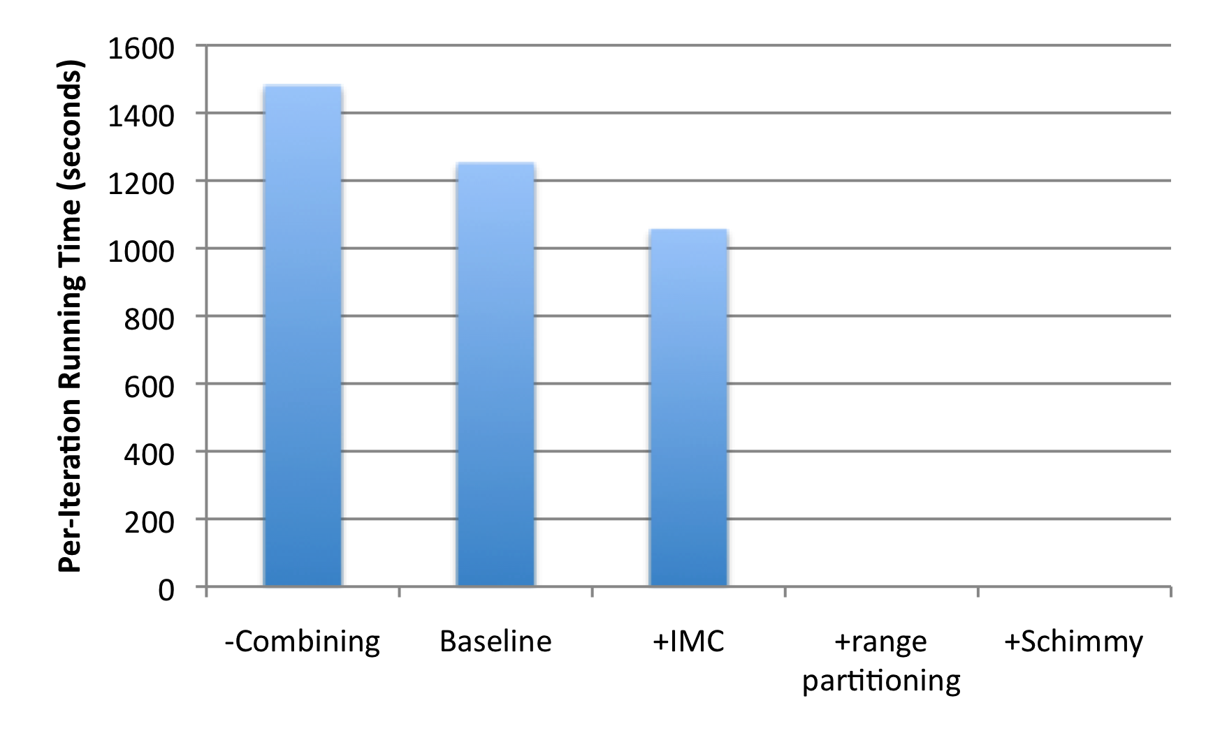
How much difference does it make?
+18%
1.4b
674m
-15%
PageRank over webgraph (40m vertices, 1.4b edges)
Lin and Schatz. (2010) Design Patterns for Efﬁcient Graph Algorithms in MapReduce.

Slide 26
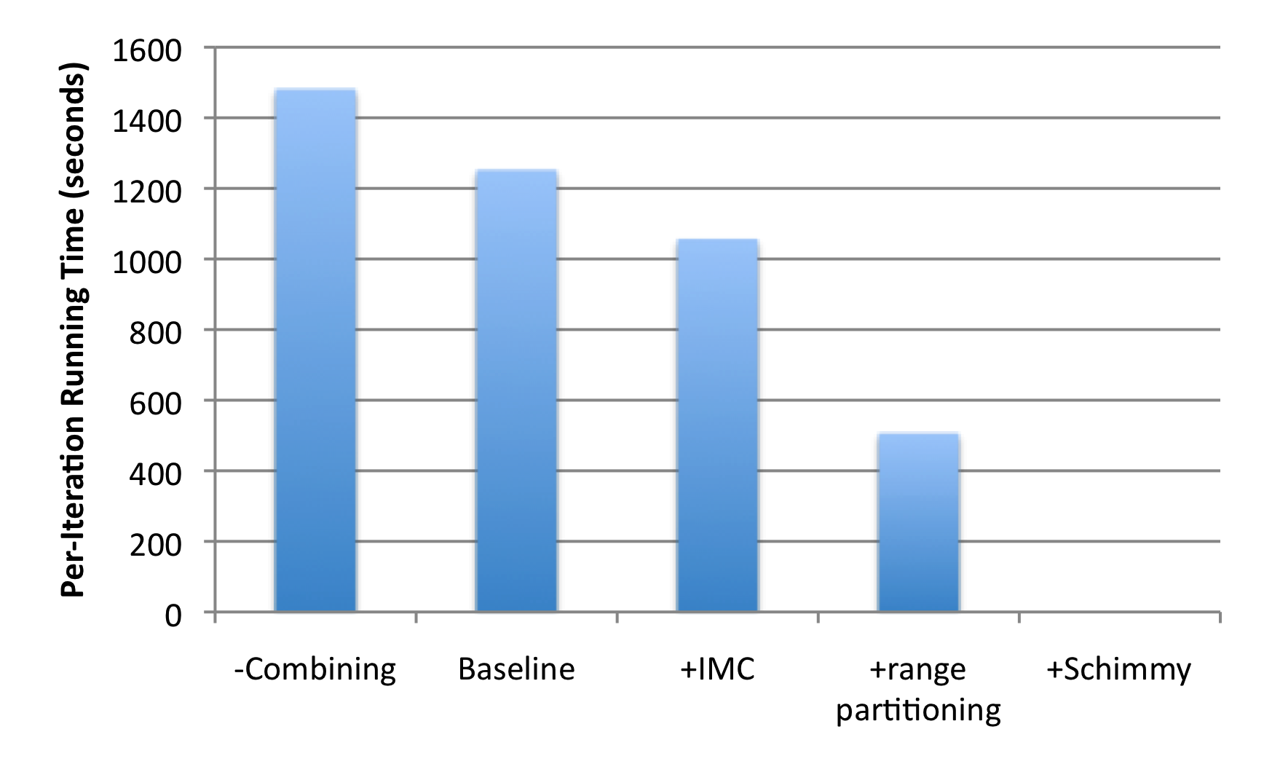
How much difference does it make?
+18%
1.4b
674m
-15%
-60%
86m
PageRank over webgraph (40m vertices, 1.4b edges)
Lin and Schatz. (2010) Design Patterns for Efﬁcient Graph Algorithms in MapReduce.

Slide 27
Schimmy Design Pattern
Basic implementation contains two dataflows:
Messages (actual computations)
Graph structure (“bookkeeping”)
Schimmy: separate the two dataflows, shuffle only the messages
Basic idea: merge join between graph structure and messages
both relations sorted by join key
both relations consistently partitioned and sorted by join key
S
S₁
T
T₁
S₂
T₂
S₃
T₃
Lin and Schatz. (2010) Design Patterns for Efﬁcient Graph Algorithms in MapReduce.

Slide 28
HDFS
HDFS
Adjacency Lists
PageRank vector
join
flatMap
reduceByKey
PageRank vector
join
flatMap
reduceByKey
PageRank vector
join
…

Slide 29
How much difference does it make?
+18%
1.4b
674m
-15%
-60%
86m
PageRank over webgraph (40m vertices, 1.4b edges)
Lin and Schatz. (2010) Design Patterns for Efﬁcient Graph Algorithms in MapReduce.

Slide 30
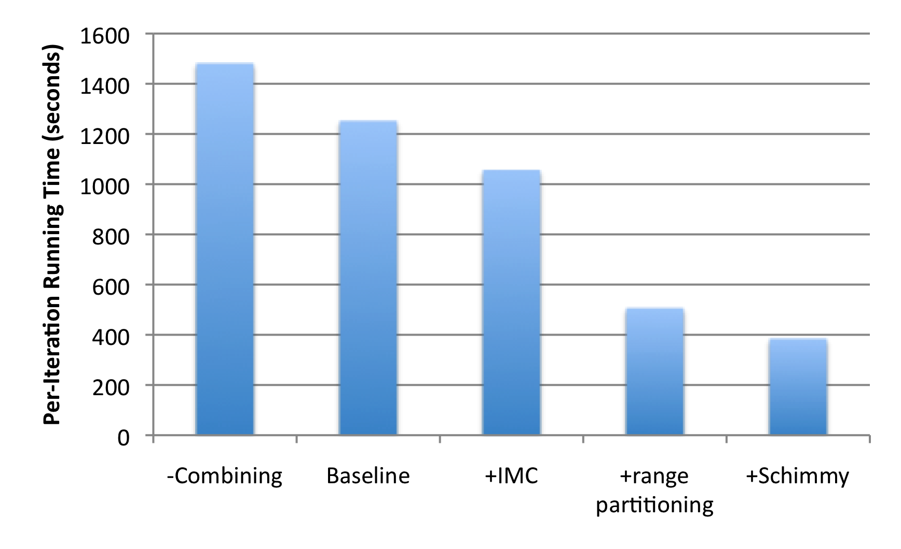
How much difference does it make?
+18%
1.4b
674m
-15%
-60%
86m
-69%
PageRank over webgraph (40m vertices, 1.4b edges)
Lin and Schatz. (2010) Design Patterns for Efﬁcient Graph Algorithms in MapReduce.

Slide 31
Simple Partitioning Techniques
Hash partitioning
Range partitioning on some underlying linearization
Web pages: lexicographic sort of domain-reversed URLs
Web pages: lexicographic sort of domain-reversed URLs
Social networks: sort by demographic characteristics

Slide 32
Country Structure in Facebook
Analysis of 721 million active users (May 2011)
54 countries w/ >1m active users, >50% penetration
Ugander et al. (2011) The Anatomy of the Facebook Social Graph.

Slide 33
Simple Partitioning Techniques
Hash partitioning
Range partitioning on some underlying linearization
Web pages: lexicographic sort of domain-reversed URLs
Social networks: sort by demographic characteristics
Web pages: lexicographic sort of domain-reversed URLs
Social networks: sort by demographic characteristics
Geo data: space-filling curves

Slide 34
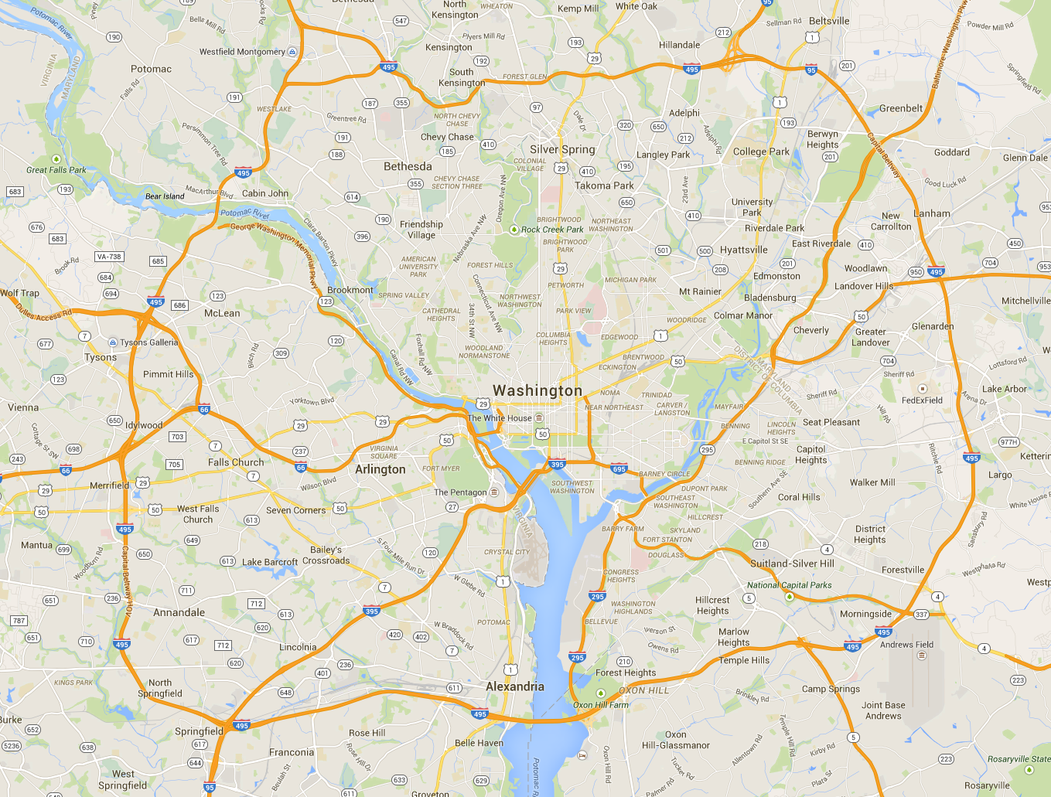
Aside: Partitioning Geo-data

Slide 35
Geo-data = regular graph

Slide 36
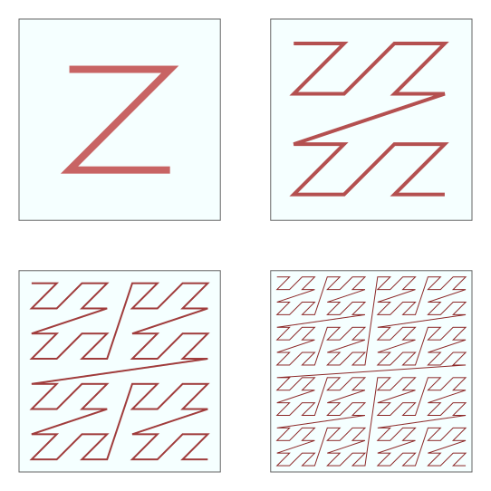
Space-filling curves: Z-Order Curves

Slide 37
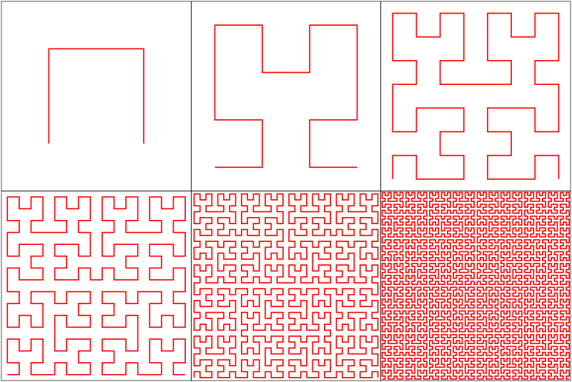
Space-filling curves: Hilbert Curves

Slide 38
Simple Partitioning Techniques
Hash partitioning
Range partitioning on some underlying linearization
Web pages: lexicographic sort of domain-reversed URLs
Social networks: sort by demographic characteristics
Geo data: space-filling curves
But what about graphs in general?

Slide 39


Source: http://www.flickr.com/photos/fusedforces/4324320625/

Slide 40
General-Purpose Graph Partitioning
Graph coarsening
Recursive bisection

Slide 41
General-Purpose Graph Partitioning
Karypis and Kumar. (1998) A Fast and High Quality Multilevel Scheme for Partitioning Irregular Graphs.

Slide 42
Graph Coarsening
Karypis and Kumar. (1998) A Fast and High Quality Multilevel Scheme for Partitioning Irregular Graphs.

Slide 43
Chicken-and-Egg
To coarsen the graph you need to identify dense local regions
To identify dense local regions quickly you to need traverse local edges
But to traverse local edges efficiently you need the local structure!
To efficiently partition the graph, you need to already know what the partitions are!
Industry solution?

Slide 44
Big Data Processing in a Nutshell
Partition
Replicate
Reduce cross-partition communication

Slide 45
Partition

Slide 46
Partition
What’s the fundamental issue?

Slide 47
Characteristics of Graph Algorithms
Parallel graph traversals
Local computations
Message passing along graph edges
Iterations

Slide 48
Partition
Slow
Fast
Fast

Slide 49
State-of-the-Art Distributed Graph Algorithms
Periodic synchronization
Fast asynchronous iterations
Fast asynchronous iterations

Slide 50
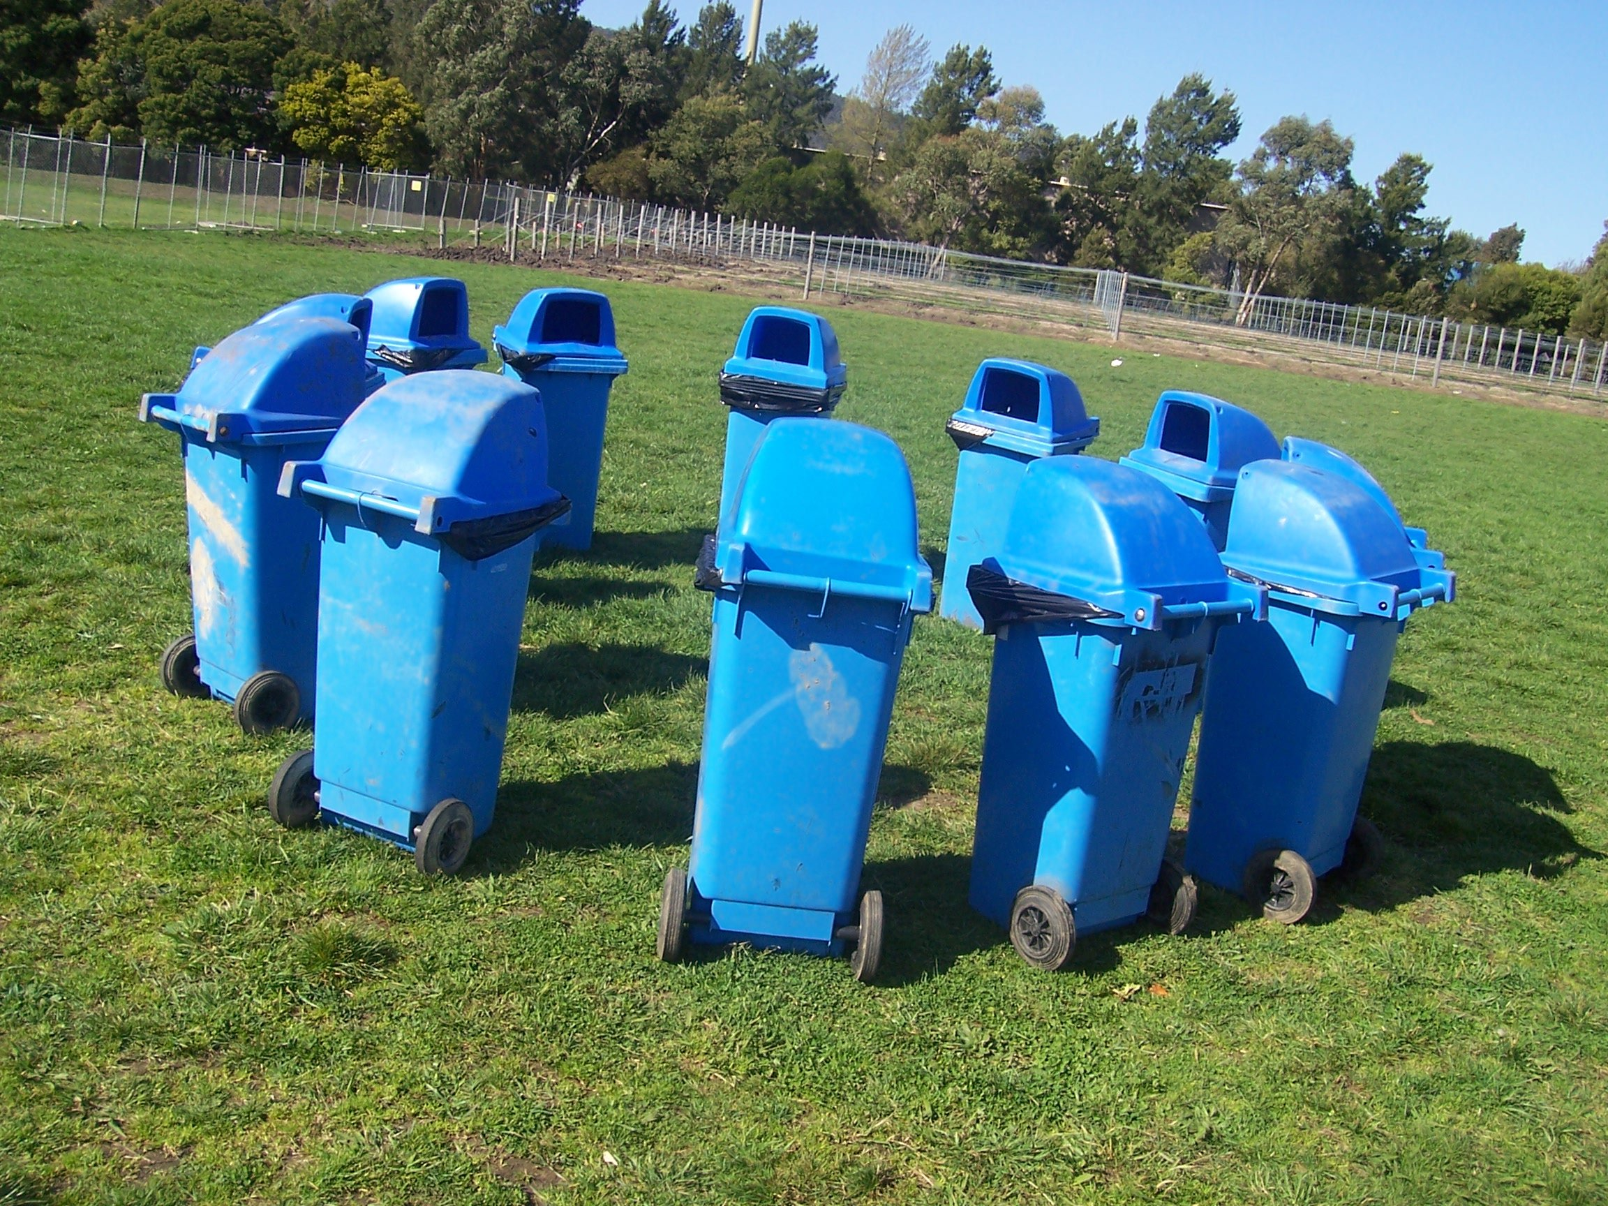
Graph Processing Frameworks
Source: Wikipedia (Waste container)

Slide 51
HDFS
HDFS
Adjacency Lists
PageRank vector
Cache!
join
flatMap
reduceByKey
Still not particularly satisfying?
PageRank vector
join
flatMap
reduceByKey
PageRank vector
join
What’s the issue?
…
Think like a vertex!

Slide 52
Pregel: Computational Model
Based on Bulk Synchronous Parallel (BSP)
Computational units encoded in a directed graph
Computation proceeds in a series of supersteps
Message passing architecture
Each vertex, at each superstep:
Receives messages directed at it from previous superstep
Executes a user-defined function (modifying state)
Emits messages to other vertices (for the next superstep)
Termination:
A vertex can choose to deactivate itself
Is “woken up” if new messages received
Computation halts when all vertices are inactive

Slide 53
superstep t
superstep t+1
superstep t+2
Source: Malewicz et al. (2010) Pregel: A System for Large-Scale Graph Processing. SIGMOD.

Slide 54
Pregel: Implementation
Master-Worker architecture
Vertices are hash partitioned (by default) and assigned to workers
Everything happens in memory
Processing cycle:
Master tells all workers to advance a single superstep
Worker delivers messages from previous superstep, executing vertex computation
Messages sent asynchronously (in batches)
Worker notifies master of number of active vertices
Fault tolerance
Checkpointing
Heartbeat/revert

Slide 55
Pregel: SSSP
class ShortestPathVertex : public Vertex<int, int, int> {
void Compute(MessageIterator* msgs) {
int mindist = IsSource(vertex_id()) ? 0 : INF;
for (; !msgs->Done(); msgs->Next())
mindist = min(mindist, msgs->Value());
if (mindist < GetValue()) {
*MutableValue() = mindist;
OutEdgeIterator iter = GetOutEdgeIterator();
for (; !iter.Done(); iter.Next())
SendMessageTo(iter.Target(),
mindist + iter.GetValue());
}
VoteToHalt();
}
};
Source: Malewicz et al. (2010) Pregel: A System for Large-Scale Graph Processing. SIGMOD.

Slide 56
Pregel: PageRank
class PageRankVertex : public Vertex<double, void, double> {
public:
virtual void Compute(MessageIterator* msgs) {
if (superstep() >= 1) {
double sum = 0;
for (; !msgs->Done(); msgs->Next())
sum += msgs->Value();
*MutableValue() = 0.15 / NumVertices() + 0.85 * sum;
}
if (superstep() < 30) {
const int64 n = GetOutEdgeIterator().size();
SendMessageToAllNeighbors(GetValue() / n);
} else {
VoteToHalt();
}
}
};
Source: Malewicz et al. (2010) Pregel: A System for Large-Scale Graph Processing. SIGMOD.

Slide 57
Pregel: Combiners
class MinIntCombiner : public Combiner<int> {
virtual void Combine(MessageIterator* msgs) {
int mindist = INF;
for (; !msgs->Done(); msgs->Next())
mindist = min(mindist, msgs->Value());
Output("combined_source", mindist);
}
};
Source: Malewicz et al. (2010) Pregel: A System for Large-Scale Graph Processing. SIGMOD.

Slide 59
Giraph Architecture
Master – Application coordinator
Synchronizes supersteps
Assigns partitions to workers before superstep begins
Workers – Computation & messaging
Handle I/O – reading and writing the graph
Computation/messaging of assigned partitions
ZooKeeper
Maintains global application state

Slide 60
Giraph Dataflow
1
2
3
Loading the graph
Compute/Iterate
Storing the graph
Input format
In-memory graph
Output format
Split 0
Worker 0
Load / Send
Graph
Compute / Send
Messages
Part 0
Part 0
Worker 0
Worker 0
Split 1
Part 1
Part 0
Master
Split 2
Master
Part 1
Part 1
Split 3
Load / Send
Graph
Part 2
Compute / Send
Messages
Part 2
Worker 1
Part 3
Worker 1
Worker 1
Part 2
Split 4
Part 3
Part 3
Split
Send stats / iterate!

Slide 61
Giraph Lifecycle
Vertex Lifecycle
Vote to Halt
Active
Inactive
Received Message

Slide 62
Giraph Lifecycle
Input
Compute Superstep
All Vertices Halted?
Yes
Output
No
Master halted?
Yes
No

Slide 63
Giraph Example

Slide 64
Execution Trace
Processor 1
5
5
5
5
Processor 2
1
1
5
5
5
2
2
2
5
5
Time

Slide 65
HDFS
HDFS
Adjacency Lists
PageRank vector
Cache!
join
flatMap
reduceByKey
Still not particularly satisfying?
PageRank vector
join
flatMap
reduceByKey
PageRank vector
join
…
Think like a vertex!

Slide 66
State-of-the-Art Distributed Graph Algorithms
Periodic synchronization
Fast asynchronous iterations
Fast asynchronous iterations

Slide 67
Graph Processing Frameworks
Source: Wikipedia (Waste container)

Slide 68
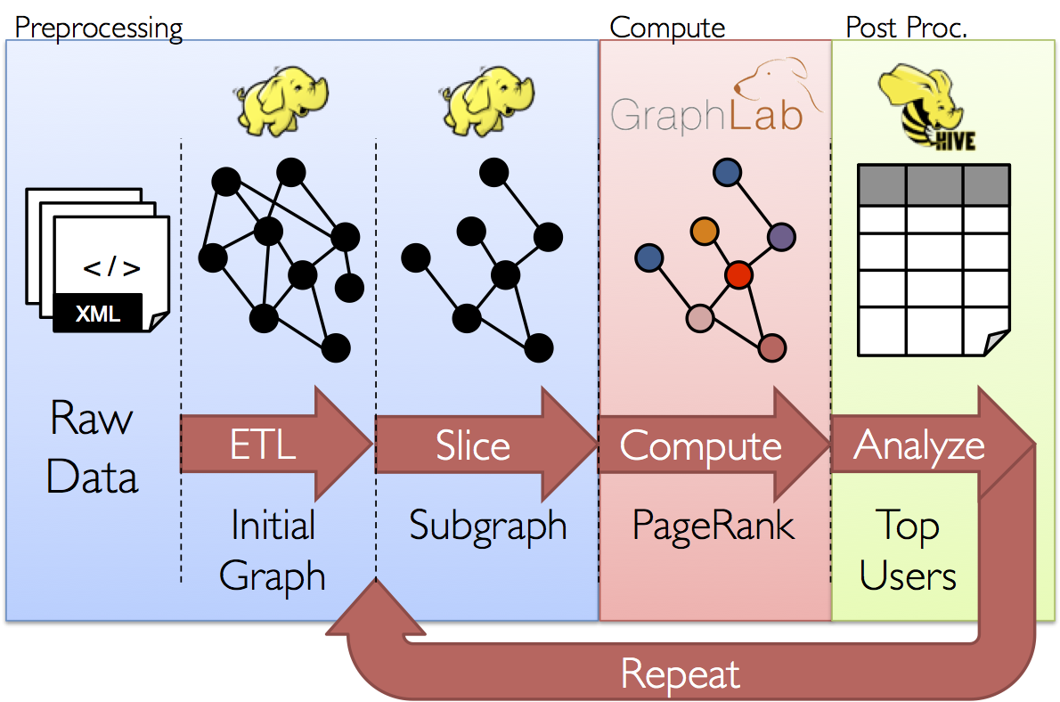
GraphX: Motivation

Slide 69
GraphX = Spark for Graphs
Integration of record-oriented and graph-oriented processing
Extends RDDs to Resilient Distributed Property Graphs
class Graph[VD, ED] {
val vertices: VertexRDD[VD]
val edges: EdgeRDD[ED]
}

Slide 70
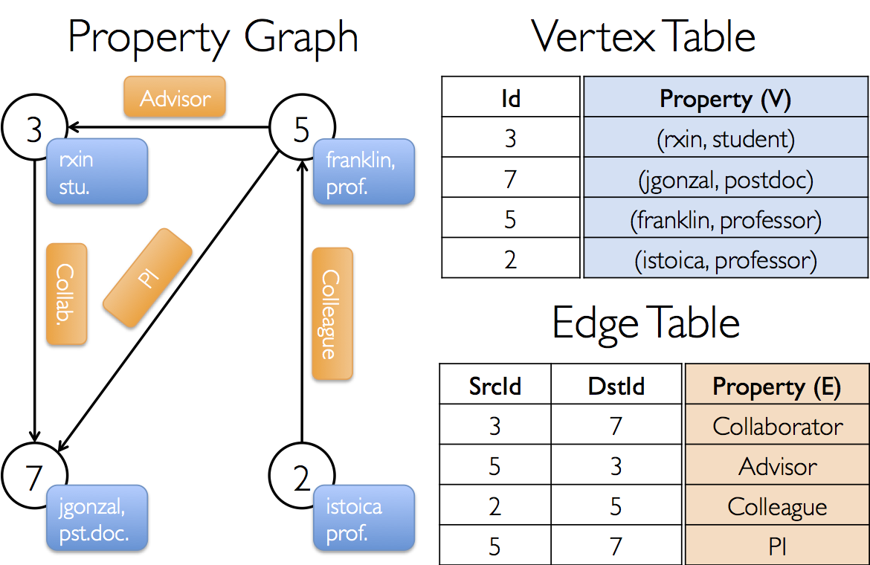
Property Graph: Example

Slide 71
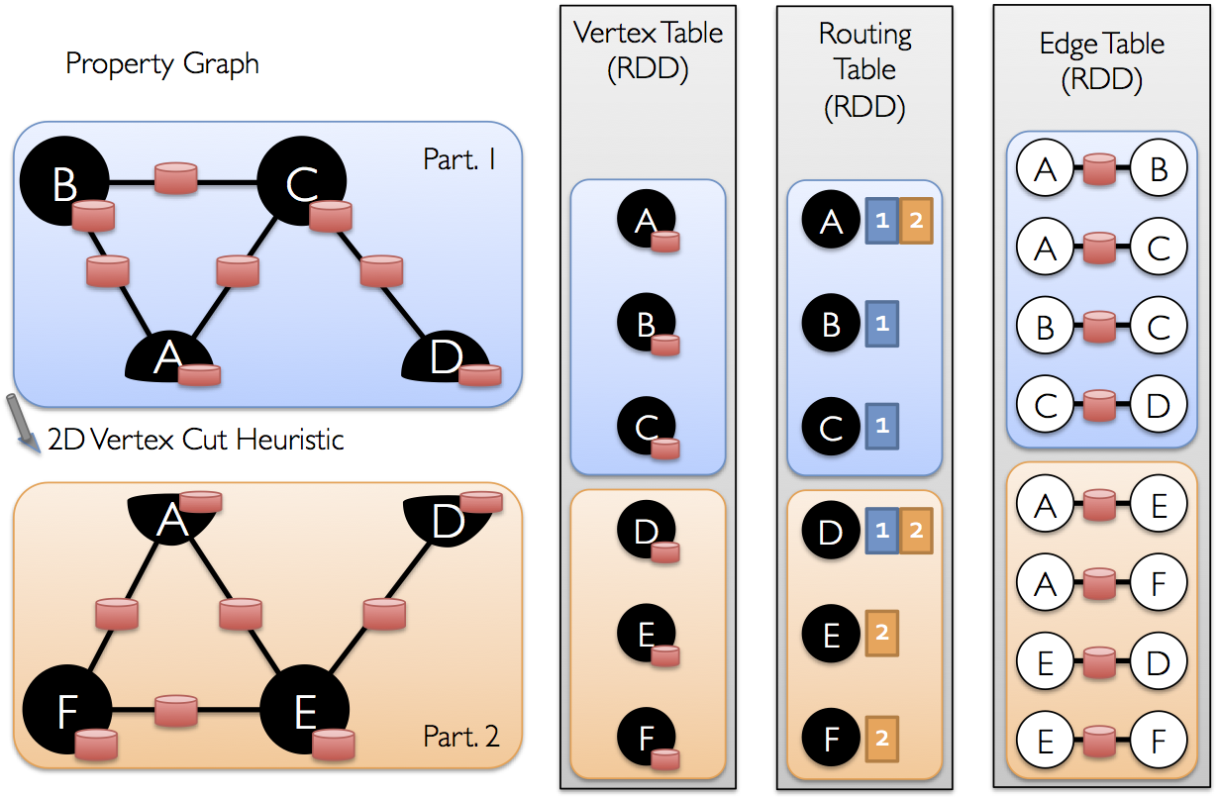
Underneath the Covers

Slide 72
GraphX Operators
“collection” view
val vertices: VertexRDD[VD]
val edges: EdgeRDD[ED]
val triplets: RDD[EdgeTriplet[VD, ED]]
Transform vertices and edges
mapVertices
mapEdges
mapTriplets
Join vertices with external table
Aggregate messages within local neighborhood
Pregel programs

Slide 73
HDFS
HDFS
Adjacency Lists
PageRank vector
Cache!
join
flatMap
reduceByKey
Still not particularly satisfying?
PageRank vector
join
flatMap
reduceByKey
PageRank vector
join
Think like a vertex!
…
(Yeah, but it’s still really all just RDDs)

Slide 74

Source: Wikipedia (Japanese rock garden)

